Slide 1
User Research Methods
Group 6
Neel Lalit Shah, Tian Wang, Ravi Kumar Pilla, Dhankuwar Sisodiya, Xin Tang, Yafu Zhang

Slide 2
Parallel Design
What is parallel design
Basic process of parallel design
Iterative VS Parallel
How to make parallel design more collaborative

Slide 3
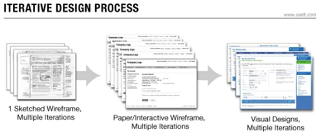
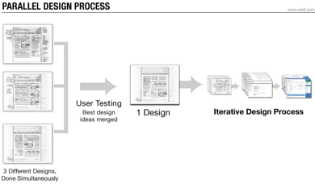
What is parallel design?

Slide 4
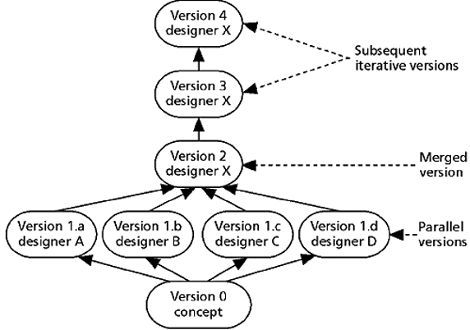
Basic process of parallel design
Invite designers to a design session. (group size)
Explain the requirements to the designers.
Ask the designers to design prototypes.
Independent
Focus on the most important elements
Carry out user testing for each design.(random order)
Interpret the results.
Create a single merged design
Proceed with iterative design.

Slide 5
Iterative vs Parallel design
Better usability in a short time
Embrace diversity to find the best
More objective evaluation without subjective orientation.

Slide 6
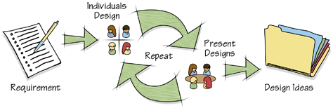
Collaborative
One time, multiple meetings.
Multiple teams, focus on the same problem.
Multiple teams, based on the previous results.
Concurrency, Collaborative Parallel Design Conference

Slide 7
System Usability Scale
What is System Usability Scale
Benefits of using SUS
Considerations while using SUS
Questionnaires
Interpreting Scores

Slide 8

Is your website usable ?
If your job depends on getting a definitive answer to this question, you should start using the System Usability Scale

Slide 9
What is System Usability Scale?
The System Usability Scale (SUS) provides a “quick and dirty”, reliable tool for measuring the usability.
It consists of a 10 item questionnaire with five response options for respondents; from Strongly agree to Strongly disagree.
Originally created by John Brooke in 1986, it allows you to evaluate a wide variety of products and services, including hardware, software, mobile devices, websites and applications.

Slide 10
What are the benefits of using SUS ?
SUS has become an industry standard, with references in over 1300 articles and publications. The noted benefits of using SUS are :
Is a very easy scale to administer to participants
Can be used on small sample sizes with reliable results
Is valid – it can effectively differentiate between usable and unusable systems

Slide 11

Some considerations while using SUS
There is a temptation, when you look at the scores, since they are on a scale of 0-100, to interpret them as percentages but they are not
The best way to interpret your results involves “normalizing” the scores to produce a percentile ranking

Slide 12
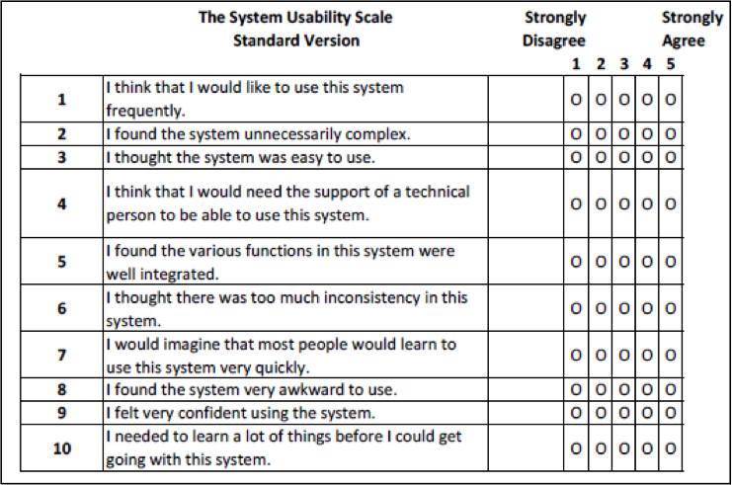
Possible Questionnaires for SUS
Notes:
It is important to note that the order in which SUS questionnaire statements appear is intentional and should not be changed to make sure the score is calculated properly.

Slide 13
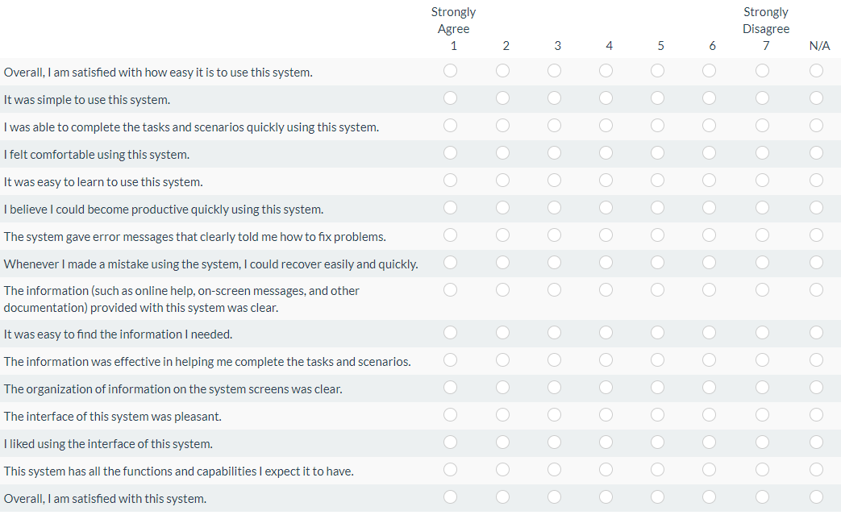
Possible Questionnaires for SUS

Slide 14
Interpreting Scores
Formula: Sum of all the scores * 2.5
US scores can be translated into letter grades
SUS Score | Letter Grade | Adjective Rating
Above 80.3 | A | Excellent
Between 68 & 80.3 | B | Good
68 | C | OK
Between 51 & 67 | D | Poor
Below 51 | F | Awful

Slide 15
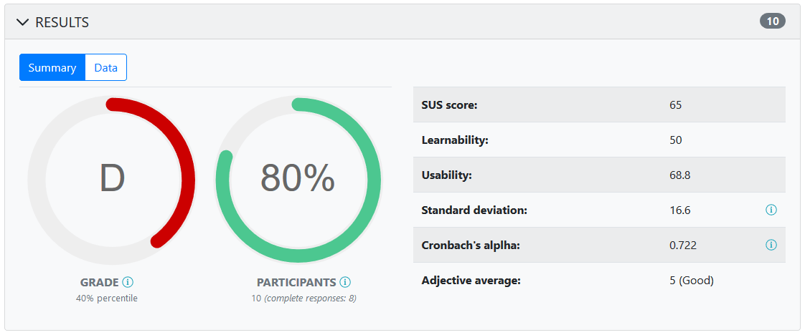

Slide 16
In addition, analyzed results produce the report with the following values:
Net Promoter Score Learnability Score Usability Score Standard deviation Cronbach’s alpha Adjective average

Slide 17
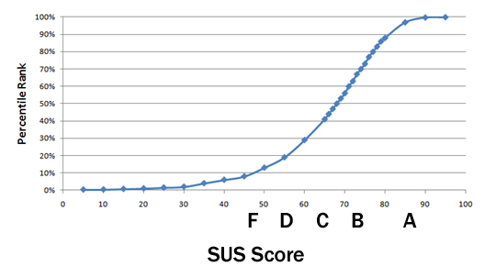
What is a good SUS score?
The 68 threshold
Process of normalizing
Grading on a curve

Slide 18


Online Surveys

Slide 19
Outlines
What is a Survey
A Good Survey
Types of questions in Surveys
Benefits of Surveys
Tools for an Online Survey

Slide 20



What is a Survey
A survey is a set of questions used to collect topic-specific information from a representative sample of your target audience.

Slide 21
A Good Survey
Keep short
Stay focused on one topic
Contain a mix of closed- and open-ended questions

Slide 22
Types of questions in Surveys
Closed Questions
These questions get the quantitative data from the users.
Open Questions
Open Questions are the qualitative data about a user’s behavior, action.

Slide 23
Benefits of Surveys
Who your users are
What your users want
What they purchase
Where they shop
What they own
What they think of your brand or product.
Design better products
Mitigating risk
Providing stakeholders with confidence

Slide 24
Tools for an Online Survey
Survey Monkey
Survey Gizmo
Wufoo

Slide 25
References
https://usabilitygeek.com/how-to-use-the-system-usability-scale-sus-to-evaluate-the-usability-of-your-website/
https://www.usability.gov/how-to-and-tools/methods/system-usability-scale.html
https://www.usabilitest.com/system-usability-scale
https://measuringu.com/sus/

Slide 26
Thank you
Group 6
Neel Lalit Shah, Tian Wang, Ravi Kumar Pilla, Dhankuwar Sisodiya, Xin Tang, Yafu Zhang

